Slide 1


Game Dev!
A glimpse at game development
By: Me ☺

Slide 2
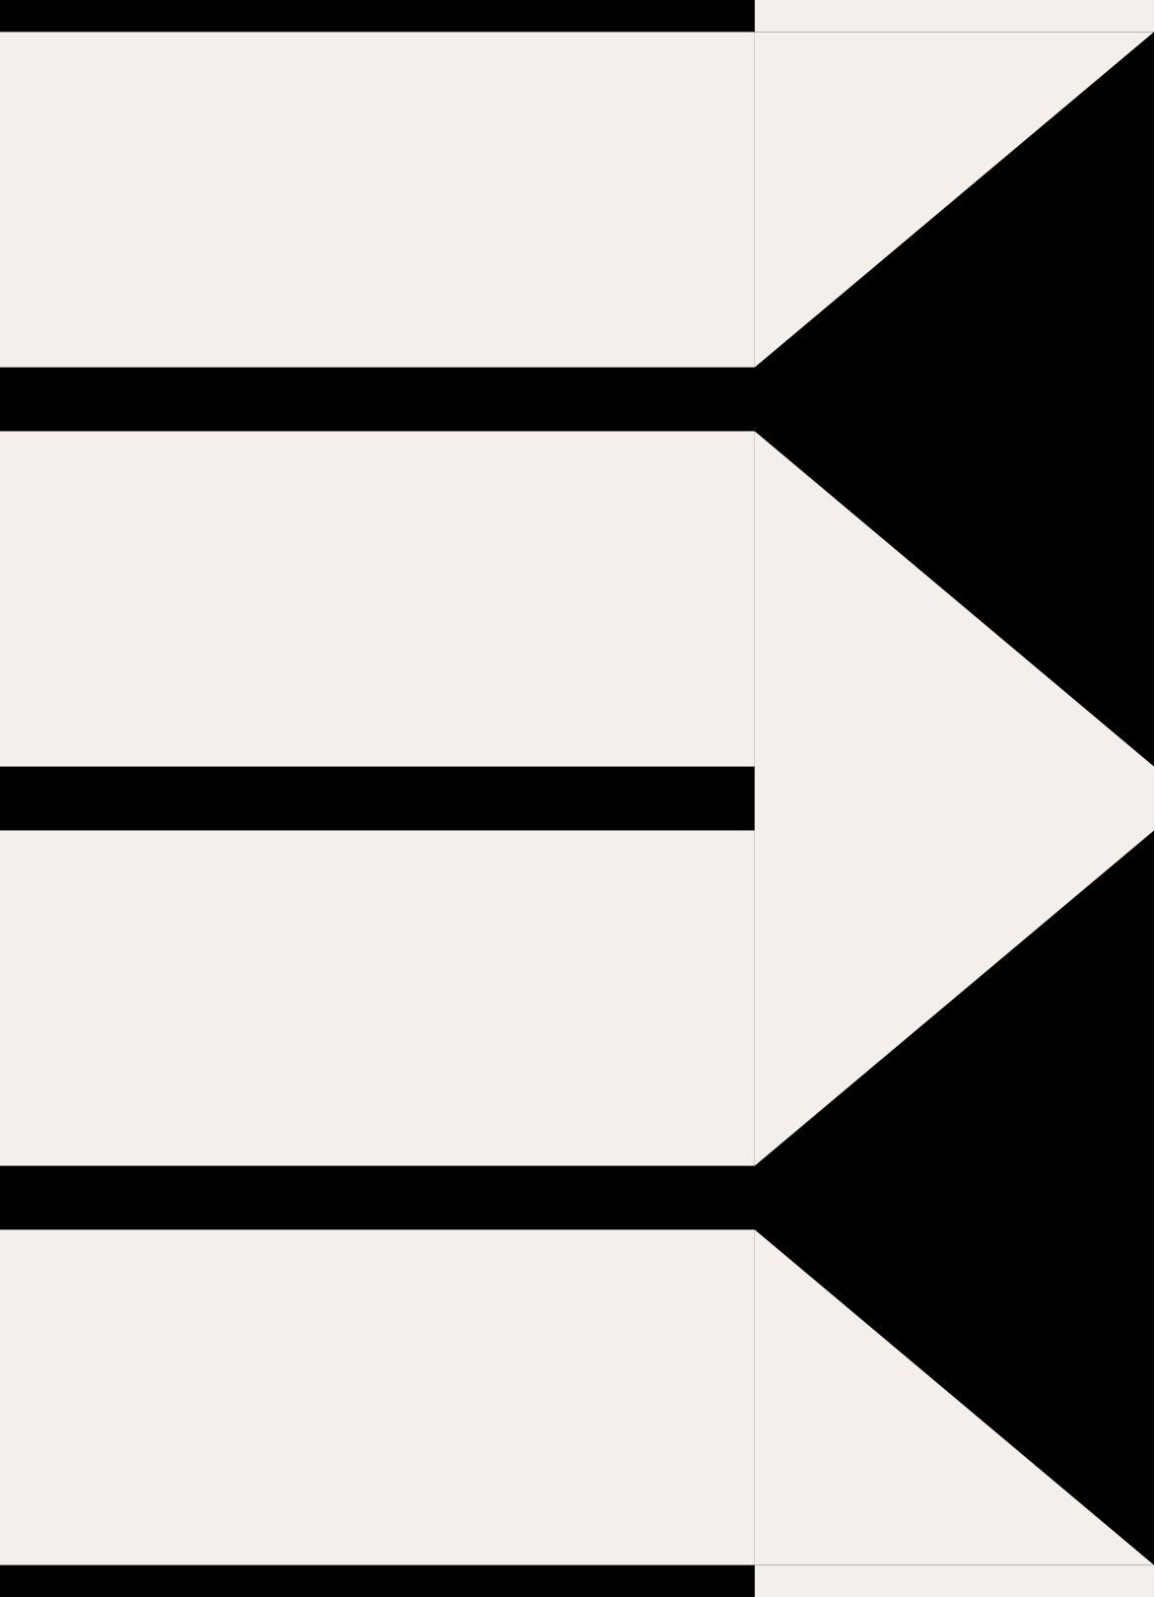

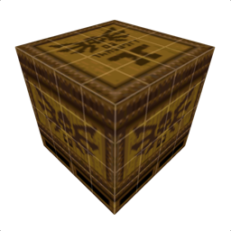

introduction
godot
trenchbroom
gimp
demo!

Slide 3
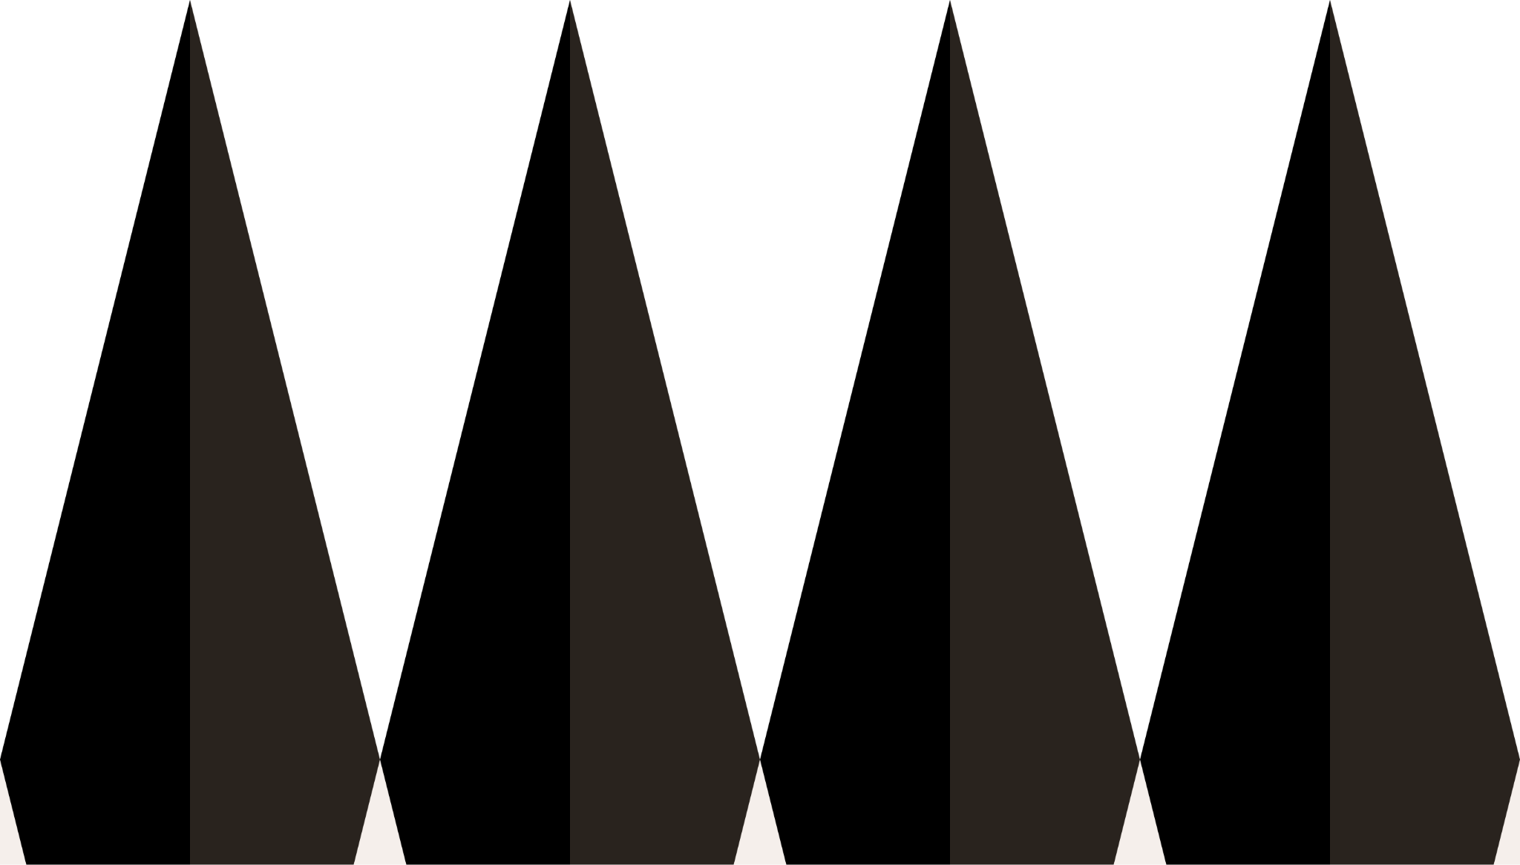
introduction
001

Slide 4

introduction to game development!
In game dev, there are a couple of key components that are required to create a project and most importantly turn that project into a game!
Game Design
Game Engine
Asset Creation

Slide 5
Game Development Components
Game Design
Game Engine
Asset Creations
Game Ideas
Gameplay Mechanics
Level Design
Godot
Unreal Engine
Unity
Roblox Studio
Make your own!
Blender
Gimp
Trenchbroom
Asprite

Slide 6

Godot!
002

Slide 7
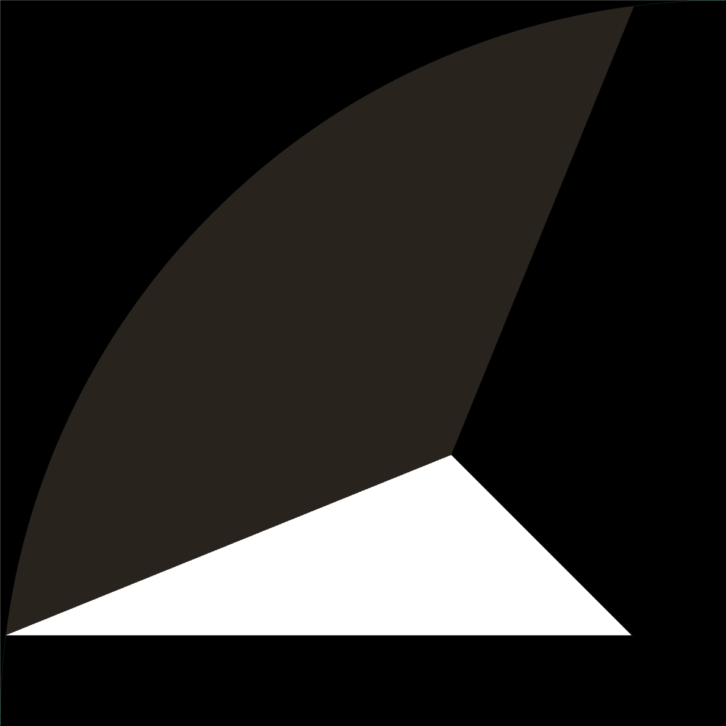
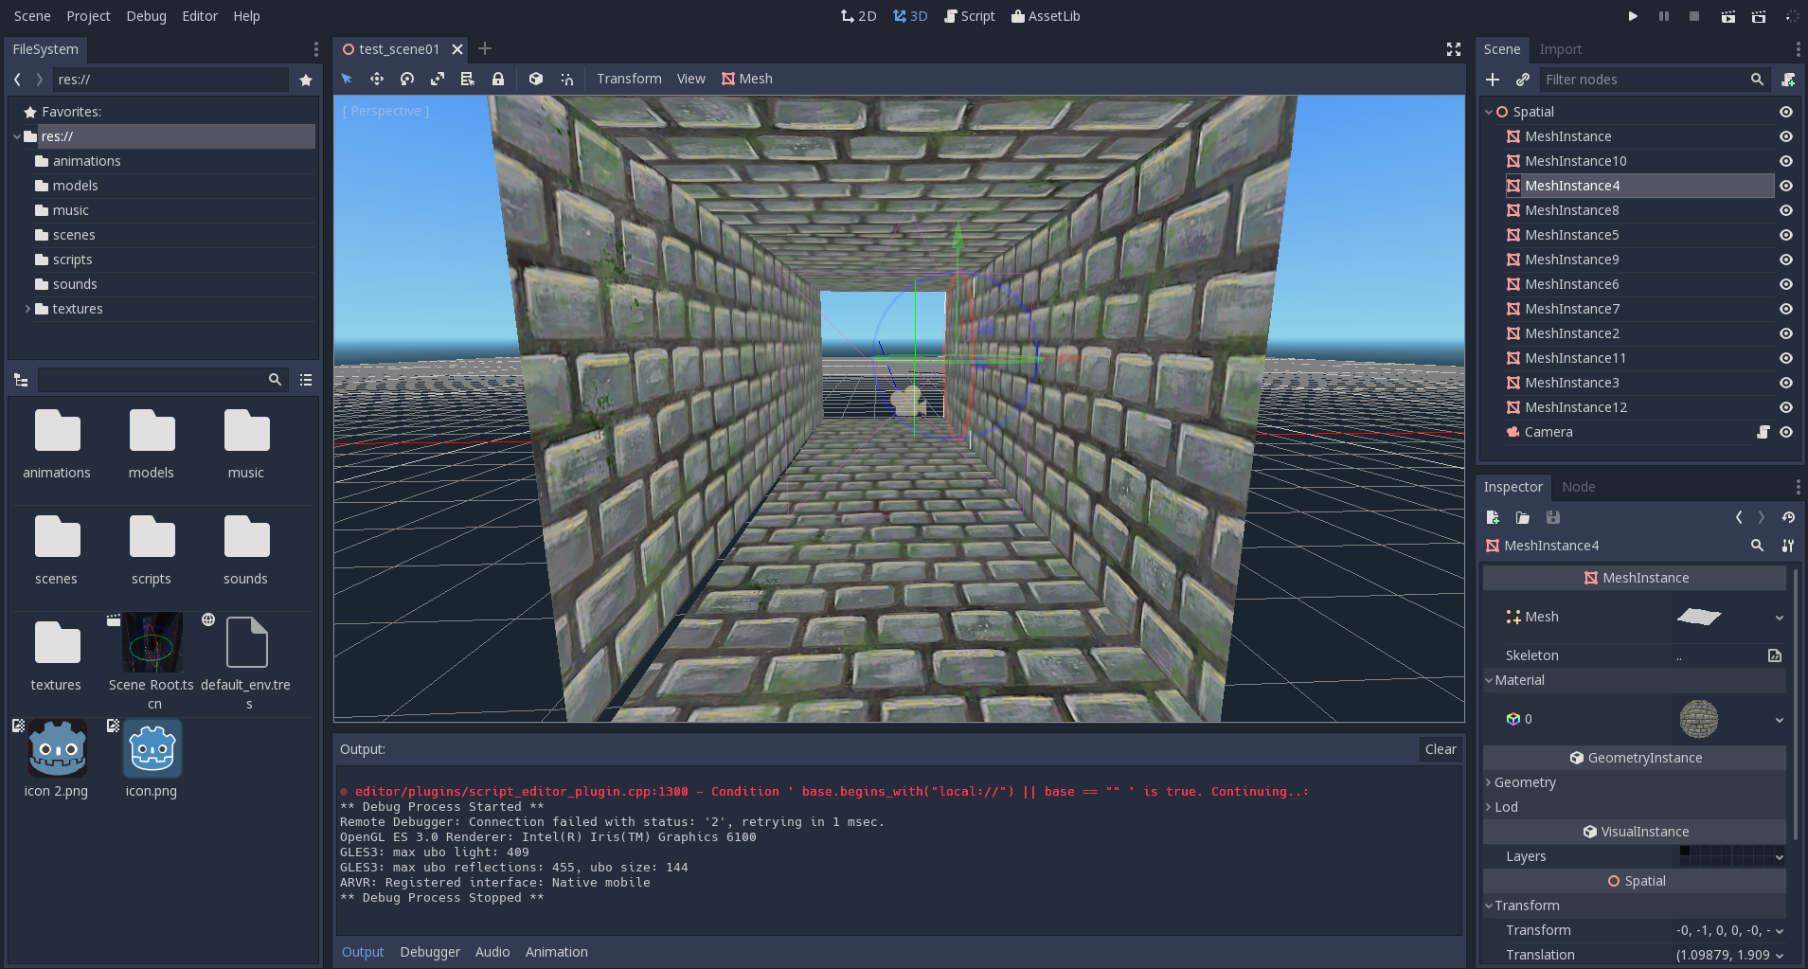
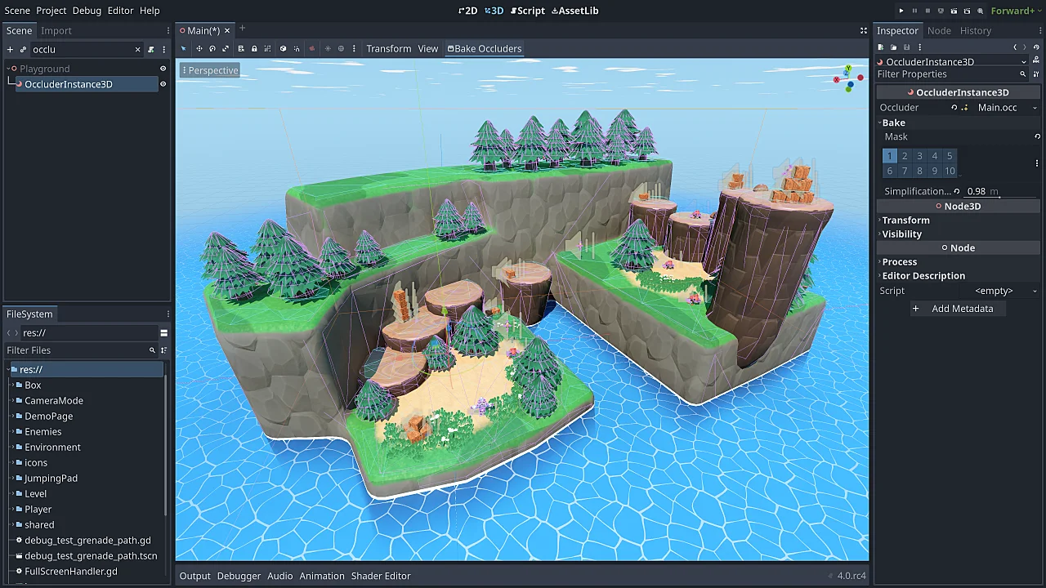
Godot!
Godot is a free, open-source game engine that allows for the creation of both 2D and 3D games.
Highly customizable with Addons
Proprietary programming language (GDScript)
- Support for C#, VisualScript, and C++

Slide 8

Trenchbroom
003

Slide 9
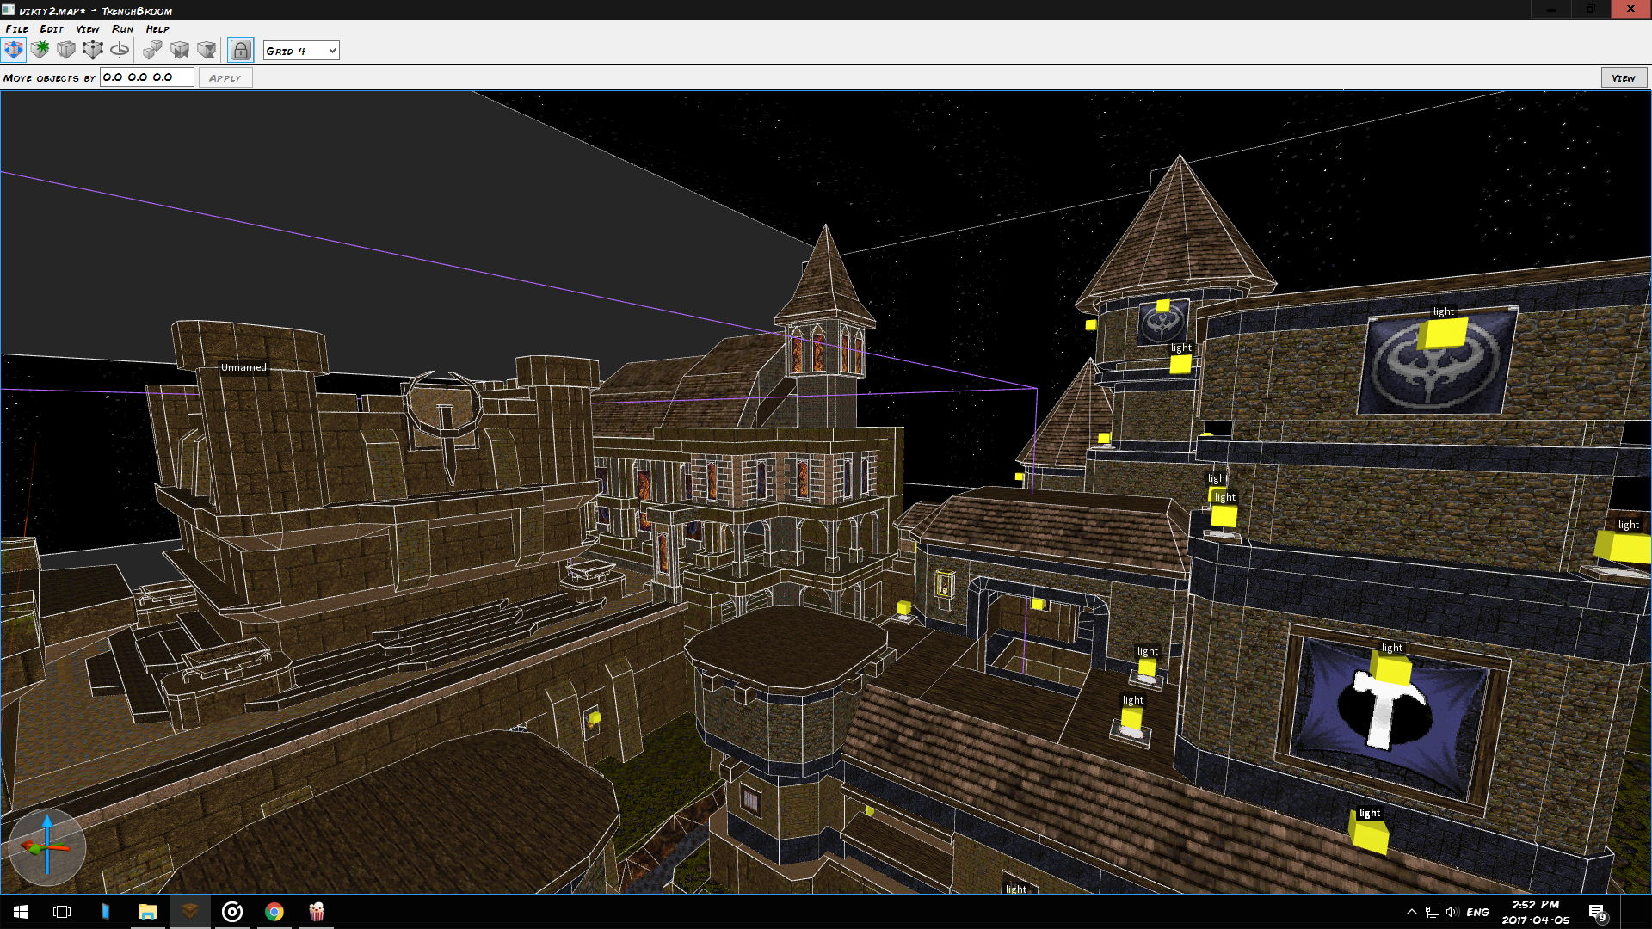
Trenchbroom
Trenchbroom is a 3D Level Editor for Quake Engine Game
Cross-platfrom! ( Windows, macOS, Linux)
Brushbased (easy to work with trust me)
Wide Game Compatability (Source Games, Quake Games)

Slide 10
Gimp
003

Slide 11
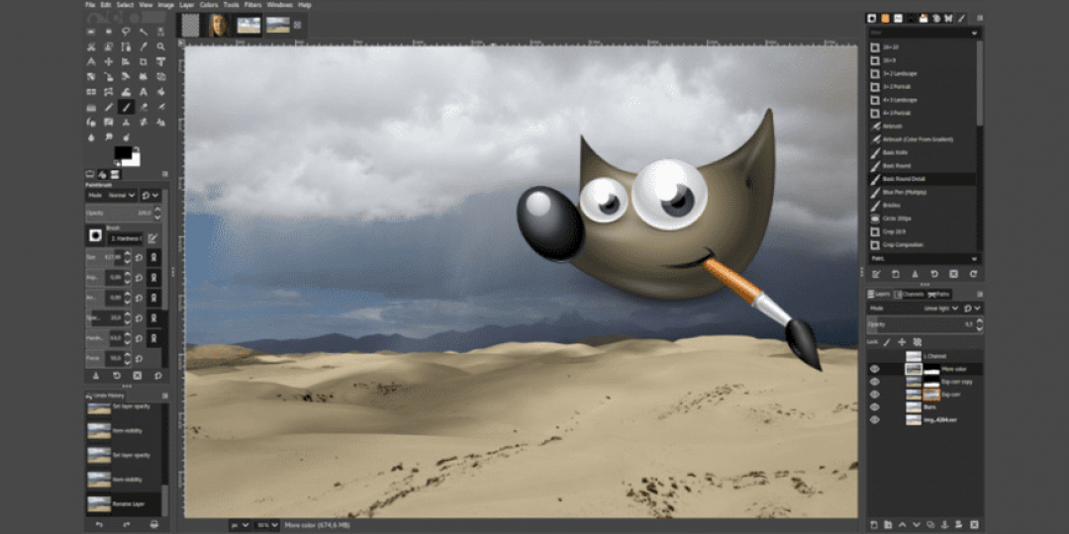
Gimp!
Gimp is short for GNU Image Manipulation Program
Basically a free image editor

Slide 12
Demo Time!

